Slide 1

Multiplayer Dungeon Quest
BIT / IV SEMESTER
Bhavishek Lama, [Roll No]
Hulas Chandra Chaudhary, [342686]
Ravi Kumar Hathi, [342696]
Notes:
Remember to keep your slides simple and easy to read. Use visuals to help illustrate your points, and use bullet points to keep text to a minimum. Make sure your font is large enough to be easily read from the back of the room. And most importantly, practice your presentation so you feel confident and comfortable on the day.
Cover Slide:
This slide should introduce your topic and include the title of your presentation and your name.

Slide 2
Contents / Agenda
Introduction
Problem Statement
Motivation
Objectives
Features
Platform (Development Environment)
Use case Diagram
DFD 1 and DFD 0
Class Diagram
Er-diagram
Proposed Timeline [Gantt Chart]
Conclusion
Notes:
Content/Agenda:
On this slide, provide a quick overview of what your presentation will cover. This will help your audience understand what to expect.

Slide 3
Introduction
Dungeon Quest Multiplayer is a 2D adventure game where players explore a dungeon world together.
Each player controls a character, moves around the map, and can see other players in real time.
The game takes place in a tile-based dungeon containing paths, walls, and water areas that affect movement.
The main idea of the game is to create a shared dungeon experience where multiple players can explore the same world at the same time, making the game more interactive and engaging than a single-player dungeon game.
Notes:
Introduction
Explain why this topic is important to you and to your intended audience.
What we present here
Providing a brief overview of the project idea
Describing the scope and goals of the project
Introducing the project team members and their roles

Slide 4
Problem Statement
Most dungeon games are designed for single players, where users explore the game world alone.
This limits interaction between players and can make the gameplay feel repetitive and less engaging.
There is a need for a simple dungeon game where multiple players can play together in the same world and see each other’s actions in real time.
This project aims to solve this problem by developing a multiplayer dungeon game that enables real-time player interaction using a network-based system.
Notes:
Problem Statement
Explain the problem you are trying to solve or the opportunity you are trying to seize. Use data or statistics to support your claims.
What we present here
Identifying the problem that the project aims to solve
Providing background information and context for the problem
Highlighting the importance and impact of the problem on the target audience or stakeholders

Slide 5
Motivation
Traditional dungeon games are mostly single-player and lack interaction.
Players enjoy games more when they can explore and play with friends online.
Multiplayer games make the world feel alive and increase engagement.
This project allows players to experience a shared dungeon adventure while learning how multiplayer systems work.
Notes:
Motivate
Explain why this problem or opportunity is important to you and to your intended audience. Use examples or stories to illustrate your point.
What we present here
Explaining the reason behind selecting this project idea
Discussing the potential benefits and outcomes of the project
Identifying any existing solutions or alternatives and their limitations

Slide 6
Objective
Develop a 2D dungeon game that supports multiple players in the same world.
Implement real-time movement synchronization using a server-client system.
Create a database-based login and account management system.
Ensure smooth character movement, collision detection, and basic animations.
Provide a foundation for adding future features like combat, items, and quests.
Notes:
Objectives
Explain your project objectives, including any specific goals you have set for yourself or your team. Be sure to explain how you will measure success.
What we present here
Defining the objectives of the project in terms of outcomes and impact
Providing a clear and measurable definition of success for the project
Outlining the target audience or stakeholders of the project and their needs

Slide 7
Features
Real-time multiplayer: See and interact with other players in the same dungeon.
Player accounts: Login and registration system with database support.
Smooth movement: Collision detection and responsive controls.
Tile-based dungeon: Walls, water, and walkable paths affect gameplay.
In-game interactions: Pause, chat, and inventory viewing.
Expandable: Can add combat, items, and other advanced features in the future.
Notes:
Features
Describe the key features of your proposed solution. Use visuals or diagrams to help illustrate how it works.
What we present here
Describing the key features and functionalities of the project
Discussing any unique or innovative aspects of the project
Outlining the expected deliverables and outcomes of the project

Slide 8
Platform/Dev. Environment
Programming Language: Java
IDE: Visual Studio Code
Database: MySQL (for player accounts and inventory)
Networking: Socket programming for real-time multiplayer
Graphics: Java Swing (2D tile-based rendering)
Operating System: Windows
Notes:
Platform / Development Environment
Explain the development environment you will be using to build your solution. Discuss any key tools or technologies you will be using.
What we present here
Identifying the programming language and development tools used for the project
Discussing any relevant technical requirements or constraints
Outlining the testing and debugging strategies for the project

Slide 9
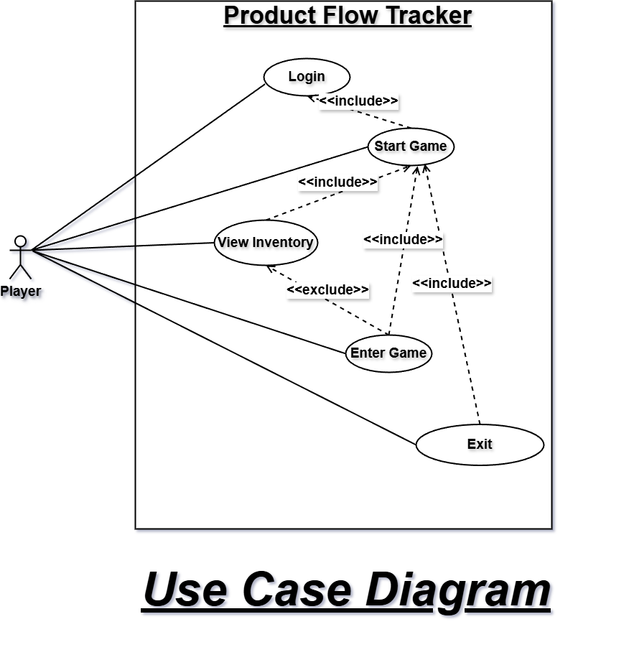
Use Case Diagram
Notes:
Platform / Development Environment
Explain the development environment you will be using to build your solution. Discuss any key tools or technologies you will be using.
What we present here
Identifying the programming language and development tools used for the project
Discussing any relevant technical requirements or constraints
Outlining the testing and debugging strategies for the project

Slide 10
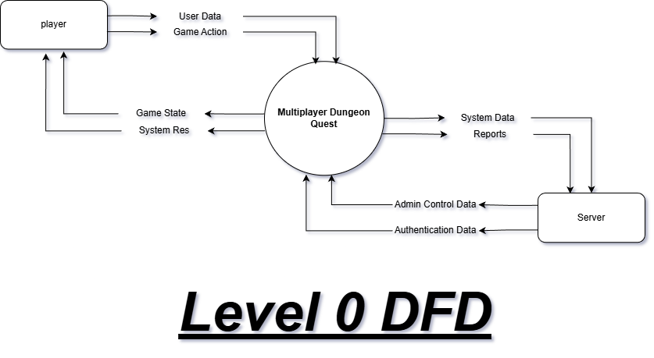
DFD 0
Notes:
Platform / Development Environment
Explain the development environment you will be using to build your solution. Discuss any key tools or technologies you will be using.
What we present here
Identifying the programming language and development tools used for the project
Discussing any relevant technical requirements or constraints
Outlining the testing and debugging strategies for the project

Slide 11
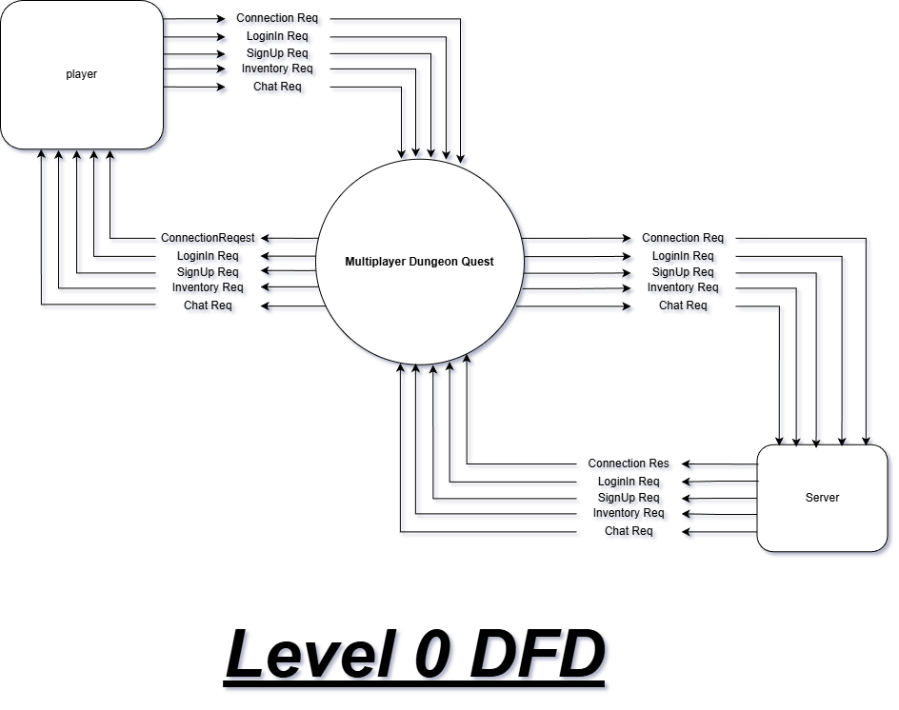
DFD 0
Notes:
Platform / Development Environment
Explain the development environment you will be using to build your solution. Discuss any key tools or technologies you will be using.
What we present here
Identifying the programming language and development tools used for the project
Discussing any relevant technical requirements or constraints
Outlining the testing and debugging strategies for the project

Slide 12
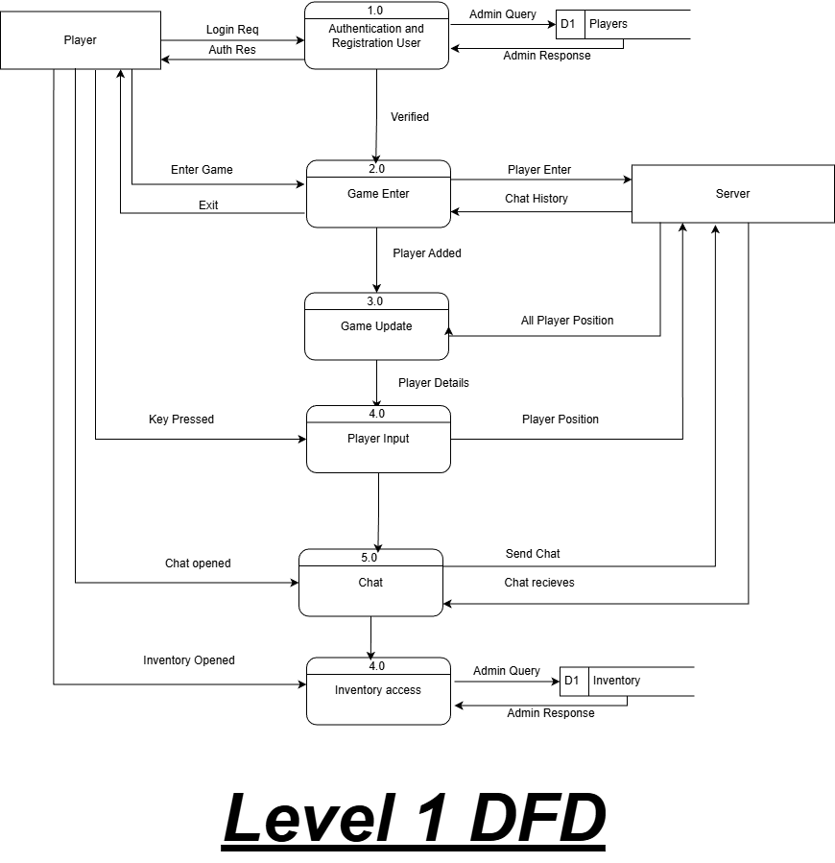
DFD 1
Notes:
Platform / Development Environment
Explain the development environment you will be using to build your solution. Discuss any key tools or technologies you will be using.
What we present here
Identifying the programming language and development tools used for the project
Discussing any relevant technical requirements or constraints
Outlining the testing and debugging strategies for the project

Slide 13
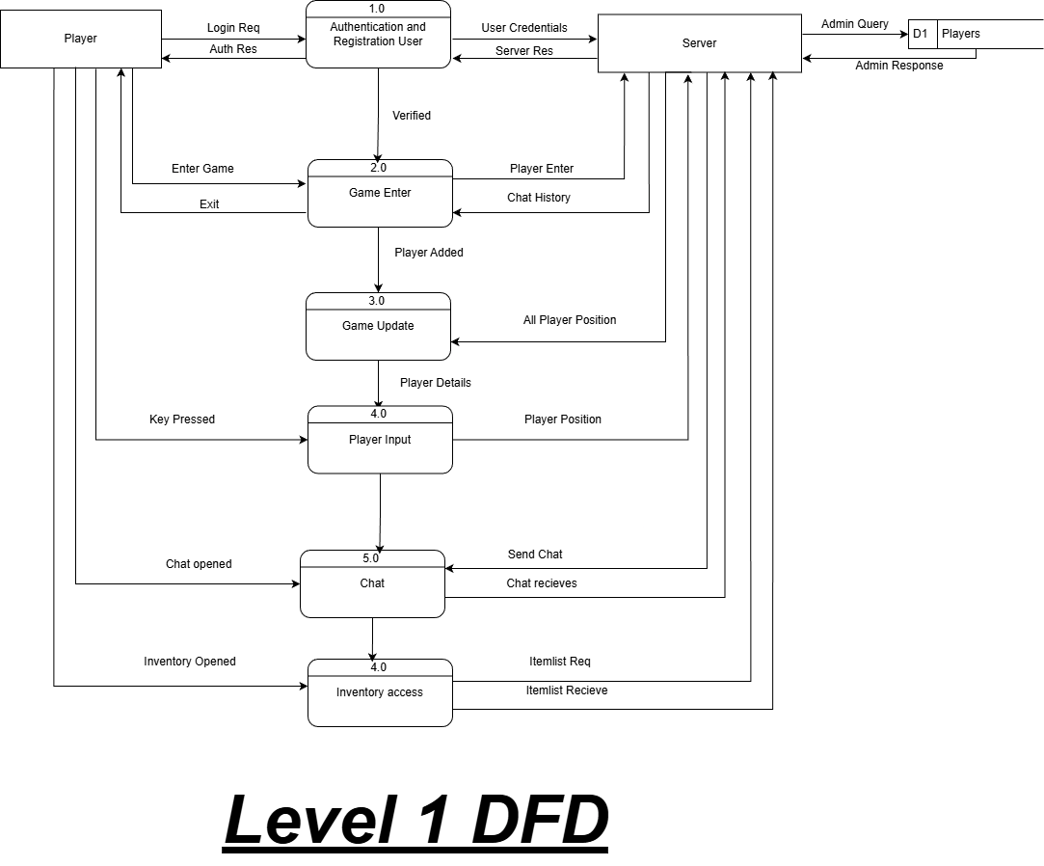
DFD 1
Notes:
Platform / Development Environment
Explain the development environment you will be using to build your solution. Discuss any key tools or technologies you will be using.
What we present here
Identifying the programming language and development tools used for the project
Discussing any relevant technical requirements or constraints
Outlining the testing and debugging strategies for the project

Slide 14
Class Diagram
Notes:
Platform / Development Environment
Explain the development environment you will be using to build your solution. Discuss any key tools or technologies you will be using.
What we present here
Identifying the programming language and development tools used for the project
Discussing any relevant technical requirements or constraints
Outlining the testing and debugging strategies for the project

Slide 15
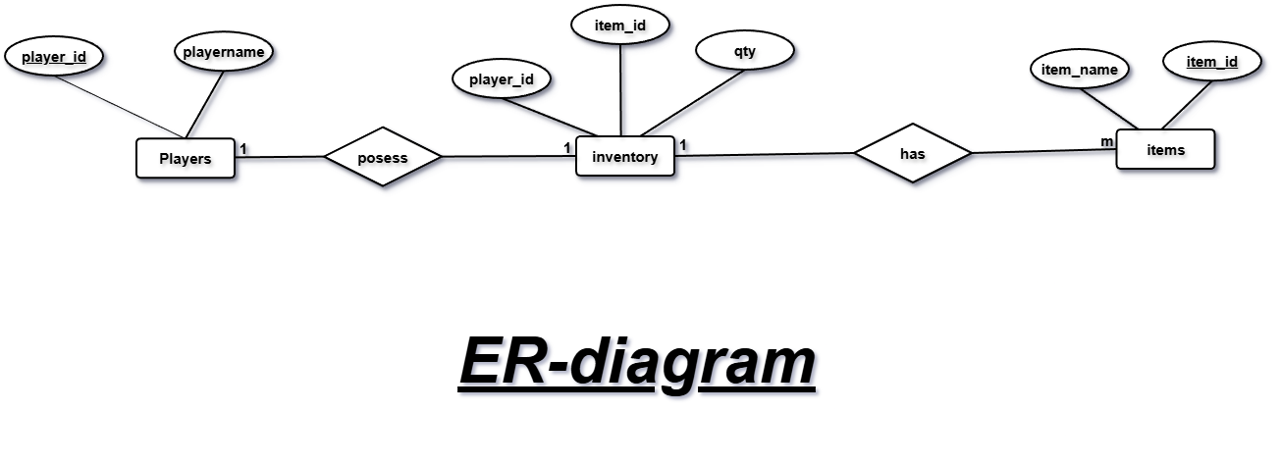
Er Diagram
Notes:
Platform / Development Environment
Explain the development environment you will be using to build your solution. Discuss any key tools or technologies you will be using.
What we present here
Identifying the programming language and development tools used for the project
Discussing any relevant technical requirements or constraints
Outlining the testing and debugging strategies for the project

Slide 16
Planned Timeline/Gantt Chart
Development Phase | Weeks
 | 1 to 2 | 2 to 3 | 3 to 4 | 4 to 5 | 5 to 6 | 6 to 7 | 7 to 8 | 8 to 9 | 9 to 10 | 10 to 11 | 11 to 12 | 12 to 13 | 13 to 14 | 14 to 15
Requirement Gathering and Analysis
Design
Coding
Testing
Documentation
Notes:
Planned Timeline / Gantt Chart (Roadmap)
Use a Gantt chart or similar tool to illustrate your proposed timeline. Be sure to include key milestones and deadlines.
What we present here
Creating a Gantt chart to show the proposed timeline for the project
Breaking down the project into manageable tasks and milestones
Identifying any critical path or dependencies in the project timeline

Slide 17
Conclusion
Dungeon Quest Multiplayer allows multiple players to explore a shared 2D dungeon in real time.
Smooth movement, collision detection, and server-client synchronization are implemented.
Provides a foundation for future features like combat, items, and advanced multiplayer interactions.
Notes:
Conclusion
Summarize your presentation and emphasize why your proposed solution is important. Thank your audience for their time.
What we present here
Summarizing the main points of the project proposal
Reiterating the relevance and significance of the project
Request for feedback and suggestions for improvement.

